Slide 1
Chat 360
BY:-
DIVIYARASU S
DHIWAKAR S R

Slide 2


Server - Client Chat Application using Python Programming

Slide 3

Introduction:-
A Client Server communication is a request-response process between two host machines.First being a client machine sends a message as a request to second host. Second host being the server machine in return replies to the clients machine as a response.

Slide 4

Connections:-
In this two scripts server.py to the server data by sending an invitation to the client,and client.py to recieve data on acceptance of the invitation.After accepting the invitation ,both server and client share messages mutually.

Slide 5
Working of Server:-
An server script performs the sequence of fuctions such as socket(), bind(), listen(), and accept() (repeats for more than one client) to communicate with the client.
socket() – creates a socket using the address family, socket type and protocol
bind() – binds the socket to the given address (host name, and port number pair)
listen() – enables a server to accept connections from the client(s)
accept() – waits and accepts connection request from the client(s)
gethostname() – retrieves host name of the machine
gethostbyname() – translates a host name to IPv4 format address
recv() – receives message sent through TCP
decode() – decodes the message using the codec
send() – sends message sent through TCP

Slide 6

Working of Client:-
An client script performs the sequence of functions such as socket(), and connect() to communicate with the server.
socket() – creates a socket using the address family, socket type and protocol
connect() – connects to a server socket at address

Slide 7

Source code:-
# server.py
import time, socket, sys
print("\nWelcome to Chat Room\n")
print("Initialising....\n")
time.sleep(1)
s = socket.socket()
host = socket.gethostname()
ip = socket.gethostbyname(host)
port = 1234
s.bind((host, port))
print(host, "(", ip, ")\n")
name = input(str("Enter your name: "))
s.listen(1)
print("\nWaiting for incoming connections...\n")
conn, addr = s.accept()
print("Received connection from ", addr[0], "(", addr[1], ")\n")

Slide 8
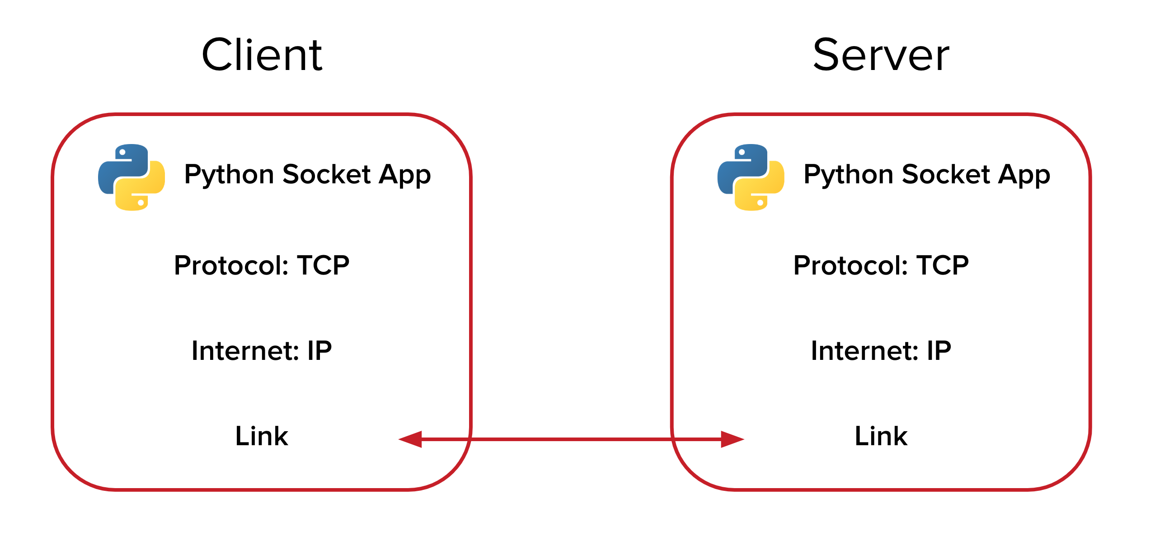
s_name = conn.recv(1024)
s_name = s_name.decode()
print(s_name, "has connected to the chat room\nEnter [e] to exit chat room\n")
conn.send(name.encode())
while True:
message = input(str("Me : "))
if message == "[e]":
message = "Left chat room!"
conn.send(message.encode())
print("\n")
break
conn.send(message.encode())
message = conn.recv(1024)
message = message.decode()
print(s_name, ":", message)

Slide 9
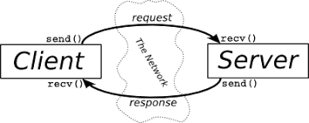
Client Code:-
# client.py
import time, socket, sys
print("\nWelcome to Chat Room\n")
print("Initialising....\n")
time.sleep(1)
s = socket.socket()
shost = socket.gethostname()
ip = socket.gethostbyname(shost)
print(shost, "(", ip, ")\n")
host = input(str("Enter server address: "))
name = input(str("\nEnter your name: "))
port = 1234
print("\nTrying to connect to ", host, "(", port, ")\n")
time.sleep(1)
s.connect((host, port))
print("Connected...\n")

Slide 10

s.send(name.encode())
s_name = s.recv(1024)
s_name = s_name.decode()
print(s_name, "has joined the chat room\nEnter [e] to exit chat room\n")
while True:
message = s.recv(1024)
message = message.decode()
print(s_name, ":", message)
message = input(str("Me : "))
if message == "[e]":
message = "Left chat room!"
s.send(message.encode())
print("\n")
break
s.send(message.encode())

Slide 11
Steps to implement:-
Run the server.py script in Python application.
Note down the local IP address and pass it to the clients (invitation). Alternatively, you can also get the local IP address through online using L-IP tool.
Run the client.py script in Python application using the local IP address sent by the server (accept the invitation).
Sent and/or receive messages from the server/client mutually.

Slide 12
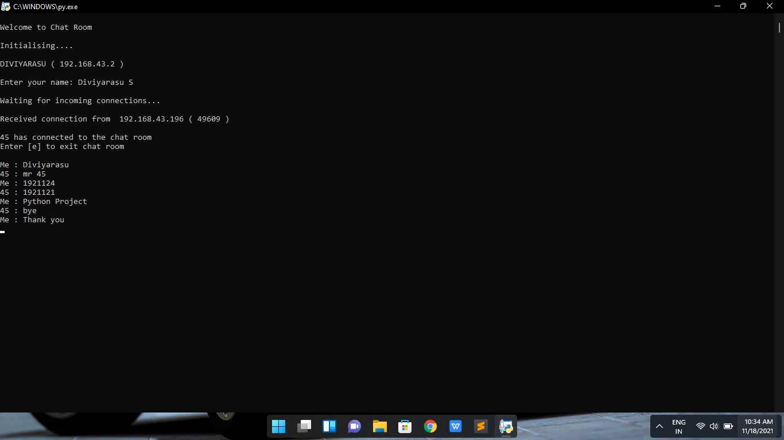
Output:- Server:

Slide 13
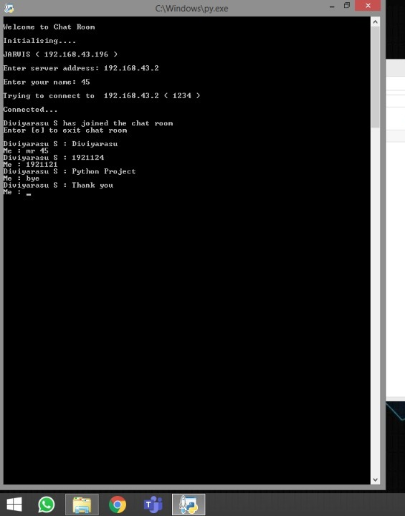
Client:

Slide 14

Conclusion:-
Writing Python programs that use IPC with sockets is rather simple.The example given above can certainly be extended to handle somthing more complex .

Slide 15
Thankyou

